Slide 1
Image Processing
Lecture 3
Example
The pixel values of the following 5×5 image are represented by 8-bit integers:
Determine f with a gray-level resolution of 2^{k} for (i) k=5 and (ii) k=3.
Solution:
Dividing the image by 2 will reduce its gray level resolution by 1 bit. Hence to reduce the gray level resolution from 8-bit to 5-bit,
8 bits – 5 bits = 3 bits will be reduced
Thus, we divide the 8-bit image by 8 (2³) to get the following 5-bit image:
Similarly, to obtain 3-bit image, we divide the 8-bit image by 2⁵ (32) to get:

Slide 2
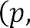
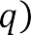
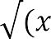
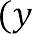

Image Processing
Lecture 3
Basic relationships between pixels
Neighbors of a Pixel
A pixel p at coordinates (x ,y) has the following neighbors:
4-neighbors
four horizontal and vertical neighbors whose coordinates are
(x + 1, y), (x - 1, y), (x, y + 1), (x, y - 1)
denoted by N₄(p)
diagonal neighbors
(x + l , y + l),(x+ l , y- l),(x-l , y + l),(x- l , y -1)
denoted by N_{D}(p)
8-neighbors
both 4-neighbors and diagonal neighbors
denoted by N₈(p)
Note: some of the neighbors of p lie outside the digital image if (x, y) is on the border of the image.
Distance Measures
For pixels p, q, and z, with coordinates (x, y), (s, t), and (v, w), respectively, D is a distance function or metric if
a) D(p, q) >= 0 ( D(p,q)=0 iff p = q ),
b) D(p,q) = D(q,p), and
c) D(p,z) <= D(p,q) + D(q,z).
Euclidean distance between p and q is defined as
City-block distance between p and q is defined as

Slide 3
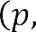
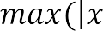
Image Processing
Lecture 3
Chessboard distance between p and q is defined as
Zooming and Shrinking Digital Images
Zooming
Zooming may be viewed as oversampling. It is the scaling of an image area A of w×h pixels by a factor s while maintaining spatial resolution
(i.e. output has sw×sh pixels). Zooming requires two steps:
creation of new pixel locations
assignment of gray levels to those new locations
There are many methods of gray-level assignments, for example nearest neighbor interpolation and bilinear interpolation.
Nearest neighbor interpolation (Zero-order hold)
is performed by repeating pixel values, thus creating a checkerboard effect. Pixel replication (a special case of nearest neighbor interpolation) is used to increase the size of an image an integer number of times. The
example below shows 8-bit image zooming by 2x (2 times) using nearest neighbor interpolation:
=
=
Original image
image with rows expanded
image with rows and columns expanded

Slide 4
Image Processing
Lecture 3
Bilinear interpolation (First-order hold)
is performed by finding linear interpolation between adjacent pixels, thus creating a blurring effect. This can be done by finding the average gray
value between two pixels and use that as the pixel value between those two. We can do this for the rows first, and then we take that result and
expand the columns in the same way. The example below shows 8-bit image zooming by 2x (2 times) using bilinear interpolation:
=
=
Original image image with rows expanded
image with rows and columns expanded
Note that the zoomed image has size 2M-1 × 2N-1. However, we can use techniques such as padding which means adding new columns and/or rows to the original image in order to perform bilinear interpolation to get zoomed image of size 2M × 2N.
The figure below shows image zooming using nearest neighbor interpolation and bilinear interpolation. We can clearly see the checkerboard and blurring effects. However, the improvements using bilinear interpolation in overall appearance are clear, especially in the 128×128 and 64×64 cases. The bilinear interpolated images are smoother than those resulted from nearest neighbor interpolation.

Slide 5
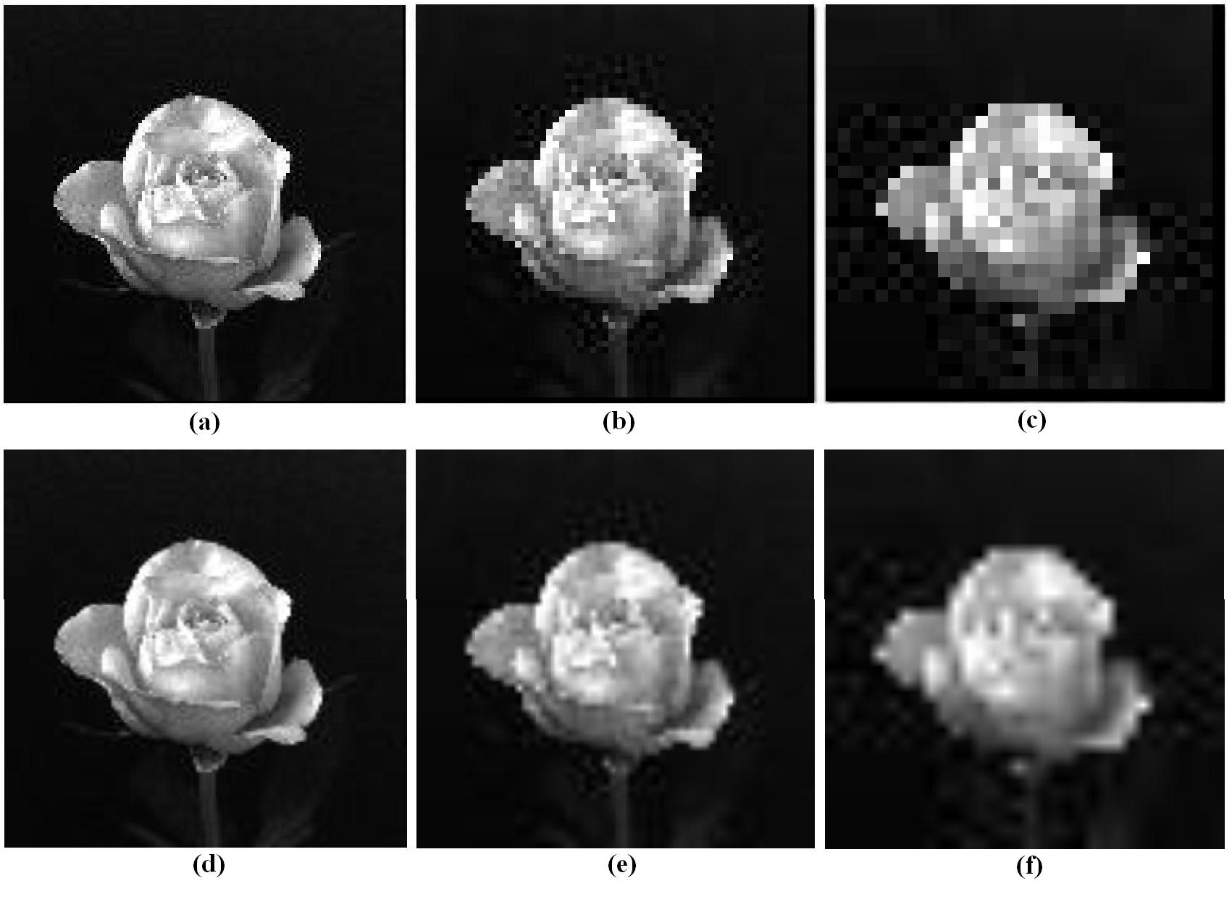
Image Processing
Lecture 3
Figure 3.1 Top row: images zoomed from 128×128, 64×64, and 32×32 pixels to 1024×1024 pixels susing nearest neighbor interpolation. Bottom row, same sequence, but using bilinear interpolation
B) Shrinking
Shrinking may be viewed as undersampling. Image shrinking is performed by row-column deletion. For example, to shrink an image by one-half, we delete every other row and column.
=
Original image
image with rows deleted
image with rows and columns deleted

Slide 6
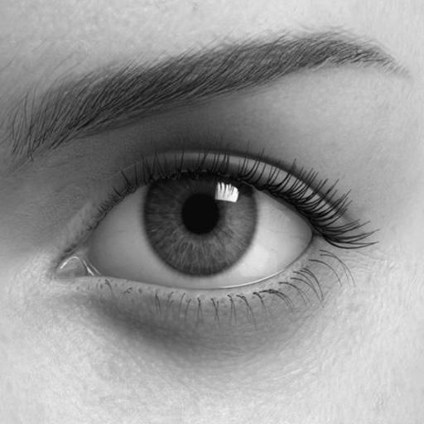
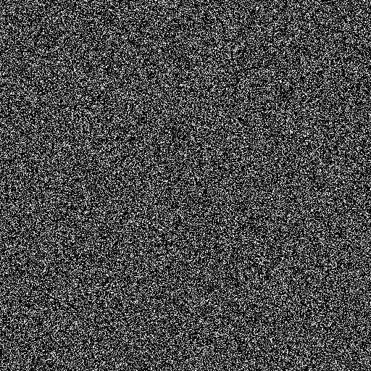
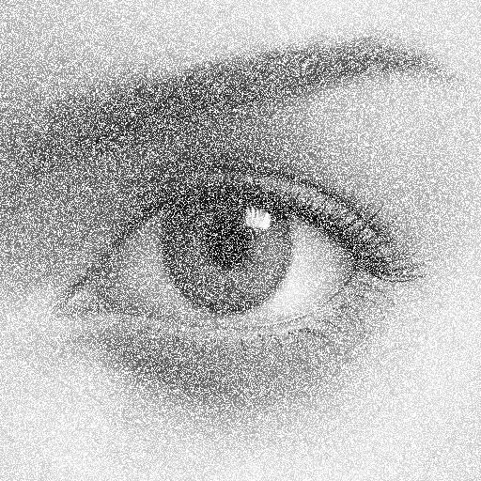
Image Processing
Lecture 3
Image algebra
There are two categories of algebraic operations applied to images:
Arithmetic
Logic
These operations are performed on a pixel-by-pixel basis between two or more images, except for the NOT logic operation which requires only one
image. For example, to add images I₁ and I₂ to create I₃:
I₃(x,y) = I₁(x,y) + I₂(x,y)
Addition is used to combine the information in two images. Applications include development of image restoration algorithms for modeling additive noise and special effects such as image morphing in motion pictures as shown in the figures below.
(a) Original image (b) Gaussian noise
Addition of images
and (b)
Figure 3.2 Image addition (adding noise to the image)

Slide 7
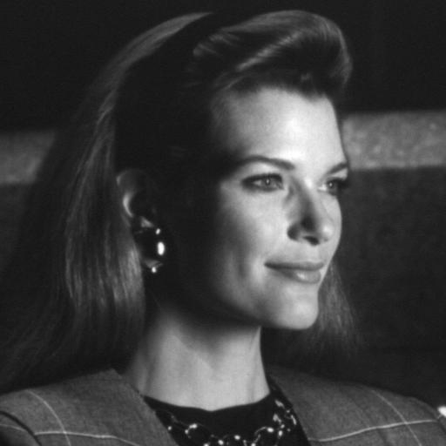
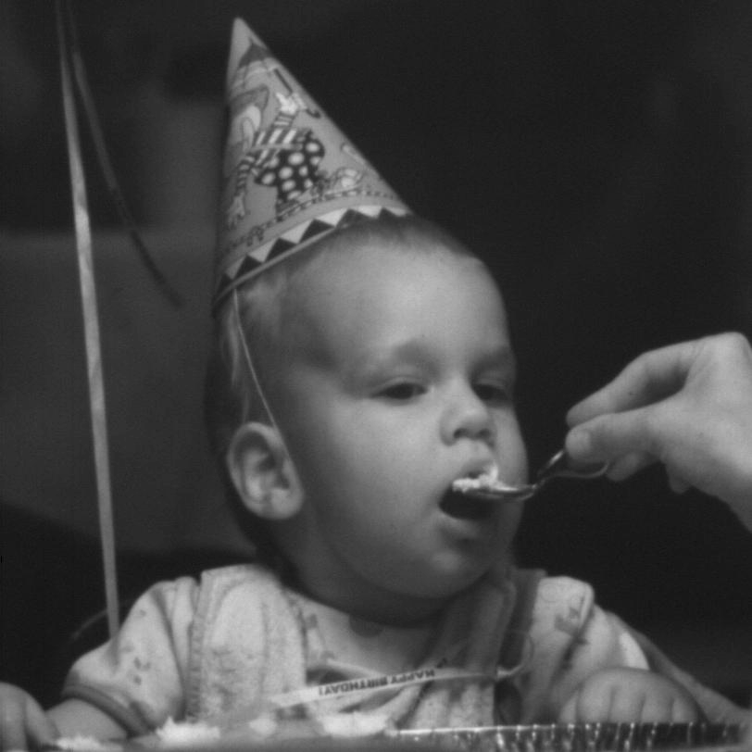
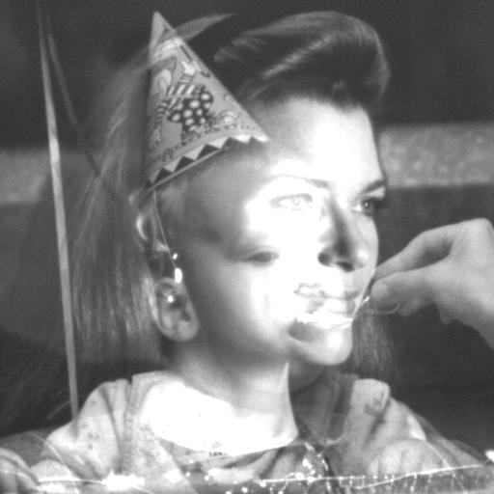
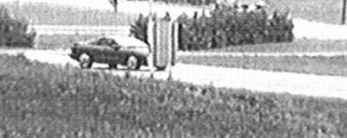
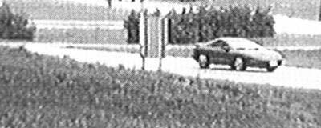
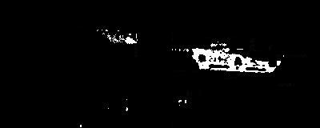
Image Processing
Lecture 3
(a) First Original
(b) Second Original
Addition of images
and (b)
Figure 3.3 Image addition (image morphing example)
Subtraction of two images is often used to detect motion. For example, in a scene when nothing has changed, the image resulting from the subtraction is filled with zeros(black image). If something has changed in the scene, subtraction produces a nonzero result at the location of movement as shown in the figure below.
(a) Original scene
(b) Same scene at a later time
(c) Subtracting image (b) from (a). Only moving objects appear in the resulting image
Figure 3.4 Image subtraction

Slide 8
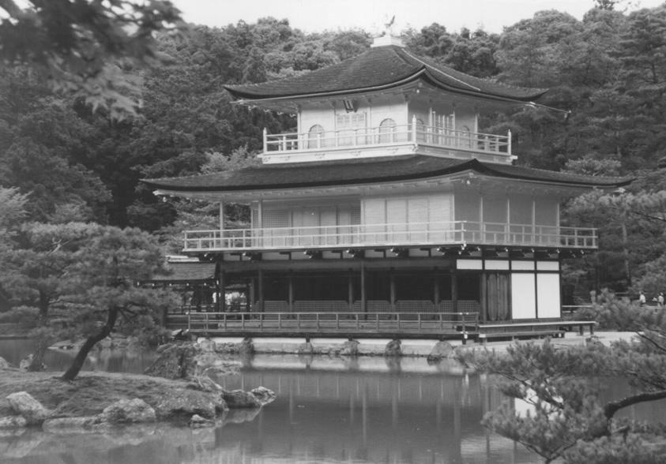
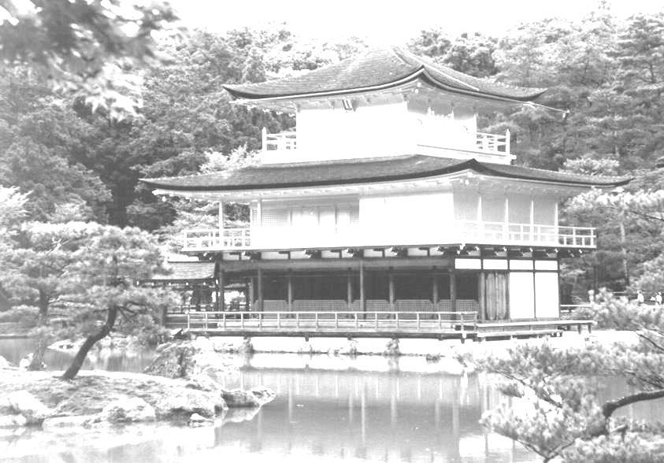
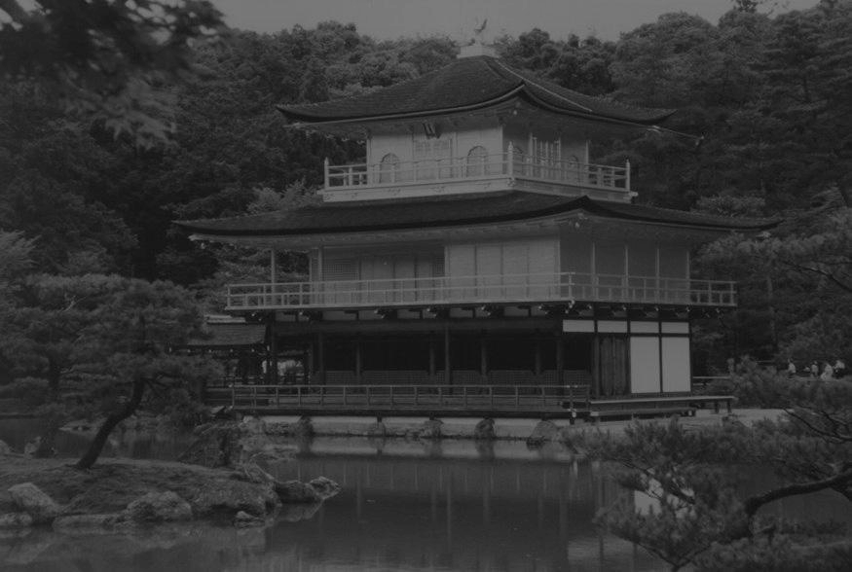
Image Processing
Lecture 3
Multiplication and division are used to adjust the brightness of an image. Multiplying the pixel values by a number greater than one will brighten the image, and dividing the pixel values by a factor greater than one will darken the image. An example of brightness adjustment is shown in the figure below.
(a) Original image
(b) Image multiplied by 2
(c) Image divided by 2
Figure 3.5 Image multiplication and division
The logic operations AND, OR, and NOT form a complete set, meaning that any other logic operation (XOR, NOR, NAND) can be created by a combination of these basic elements. They operate in a bit-wise fashion on pixel data.

Slide 9
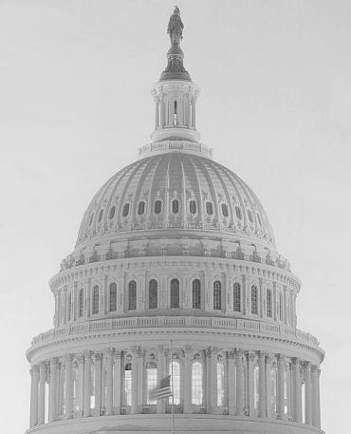
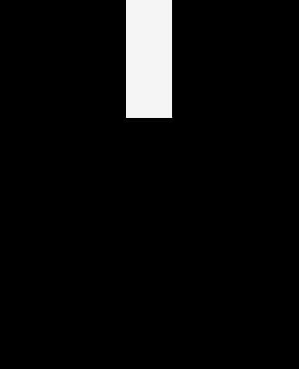


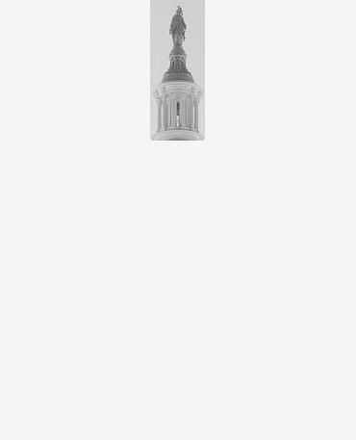
Image Processing
Lecture 3
The AND and OR operations are used to perform masking operation; that is; for selecting subimages in an image, as shown in the figure below.
Masking is also called Region of Interest (ROI) processing.
(a) Original image
(b) AND image mask
(c) Resulting image, (a) AND (b)
(d) Original image
(e) OR image mask
(f) Resulting image, (d)
OR (e)
Figure 3.6 Image masking
The NOT operation creates a negative of the original image ,as shown in the figure below, by inverting each bit within each pixel value.

Slide 10
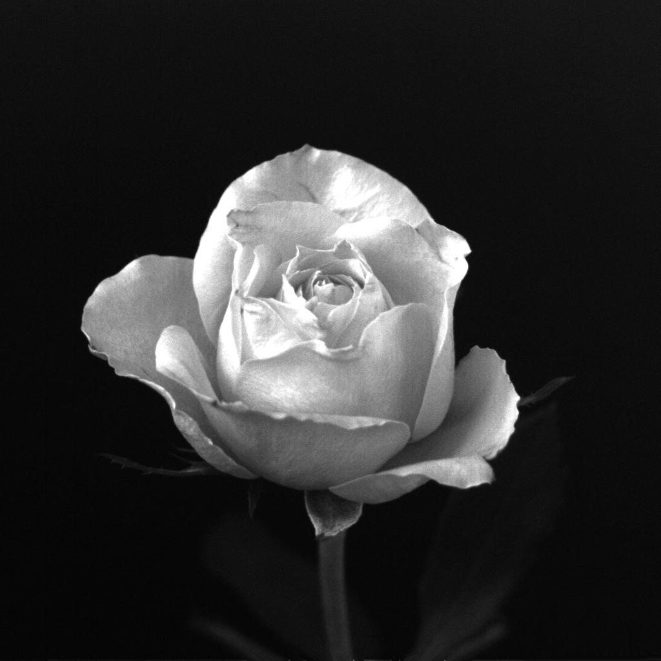
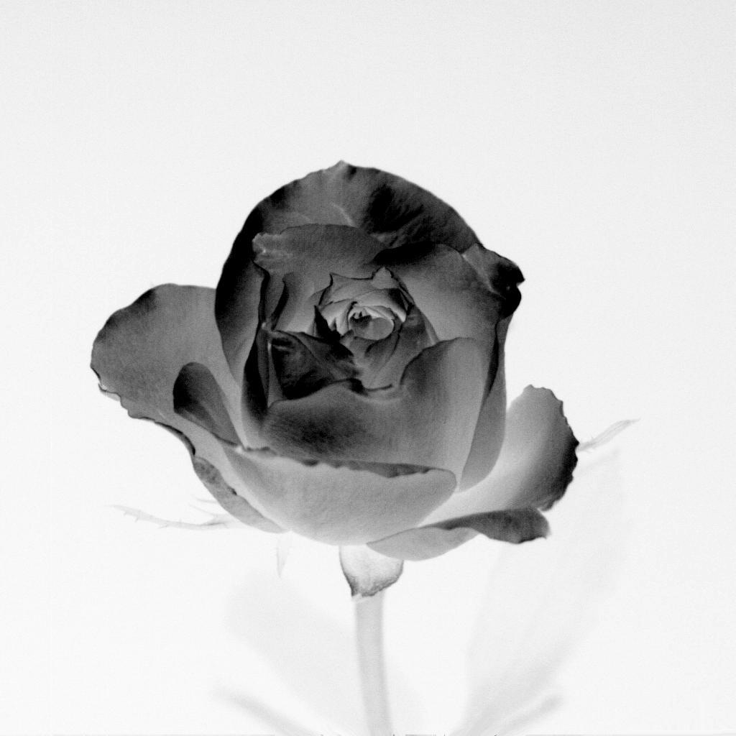
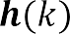
Image Processing
Lecture 3
(a) Original image (b) NOT operator applied to image (a)
Figure 3.7 Complement image
Image Histogram
The histogram of a digital image is a plot that records the frequency distribution of gray levels in that image. In other words, the histogram is a plot of the gray-level values versus the number of pixels at each gray value. The shape of the histogram provides us with useful information about the nature of the image content.
The histogram of a digital image f of size M× N and gray levels in the range [0, L-1] is a discrete function
where is the kth gray level and having gray level .
is the number of pixels in the image
The next figure shows an image and its histogram.

Slide 11
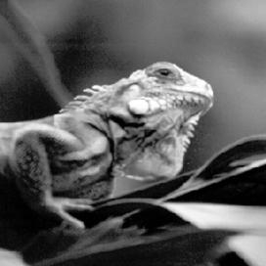
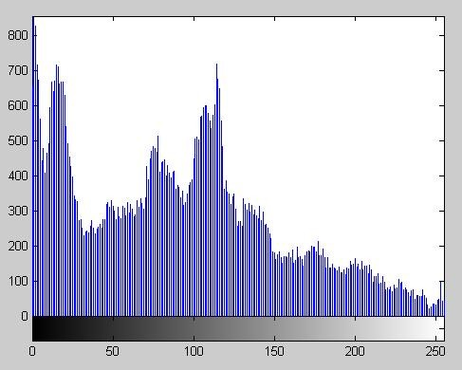
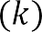
Image Processing
Lecture 3
(a) 8-bit image
(b) Histogram of image (a)
Figure 3.8 Image histogram
Note that the horizontal axis of the histogram plot (Figure 3.8(b)) represents gray level values, , from 0 to 255. The vertical axis represents the values of i.e. the number of pixels which have the gray level . The next figure shows another image and its histogram.

Slide 12
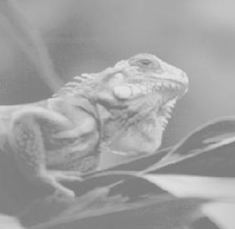
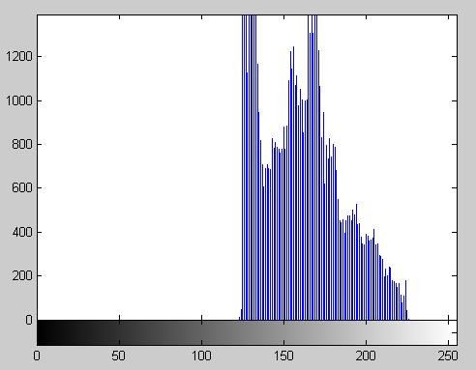
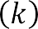

Image Processing
Lecture 3
(a) 8-bit image
(b) Histogram of image (a)
Figure 3.9 Another image histogram
It is customary to “normalize” a histogram by dividing each of its values by the total number of pixels in the image, i.e. use the probability distribution:

Slide 13


Image Processing
Lecture 3
Thus, represents the probability of occurrence of gray level .
As with any probability distribution:
all the values of a normalized histogram to 1
are less than or equal
the sum of all values is equal to 1
Histograms are used in numerous image processing techniques, such as image enhancement, compression and segmentation.

